Slide 1
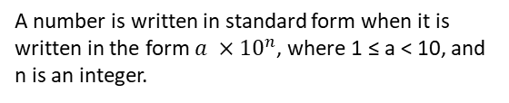


Objectives:
Keywords:
Power
Base
Index
Standard Form
To understand what standard form means.
To be able to write positive integers in standard form.
To be able to re-write numbers to be in standard form.
Introduction – Read and annotate:
Writing positive integers in the form a × 10ⁿ is a way of expressing very large or very small numbers
using powers of 10, called standard form. is part of standard form This builds on our understanding of
place value and powers of 10, and helps us write, compare, and calculate with numbers more
efficiently — especially in science and real-world contexts where such numbers often appear.
Definition
Characteristics
Standard form is a system for writing numbers.
It makes it easier to do calculations with very large or very small numbers.
Examples
Standard Form
Non - Examples
Identify whether a number is written in standard form
Example 1 - I do…
Example 2 – We do…
Example 3 – You do…
Steps | The following number is written in standard form. True / false? | The following number is written in standard form. True / false? | The following number is written in standard form. True / false?
1) Is the first number more than or equal to 1, and less than 10? 2) Is the index an integer? 3) If the answer is yes to both 1) and 2), the number is written in standard form.

Slide 2
Independent Practice
1. The following numbers are written in standard form – true or false?
True True False False
True False True True
True True False False
Converting ordinary numbers to standard form
Example 4 - I do…
Example 5 – We do…
Example 6 – You do…
Steps | Write in standard form: | Write in standard form: | Write in standard form:
1) What will the first number be? | 520 |  | 38,000
2) What power of 10 does it need to be multiplied by to keep it equal?
5.2 x 10²
3.8 x 10⁴
6.52 x 10⁵
Independent Practice
2. Write these numbers in standard form:
a) 200 | b) 2000
c) 20,000 | d) 29,000
e) 29,400 | f) 29,470
g) 294,700 | h) 994,700
i) 1,994,700 | j) 19,947
k) 10,000 | l) 10,100
m) 10,010 | n) 1,001,000,000
2 x 10³
2 x 10²
2 x 10⁴
2.9 x 10⁴
2.94 x 10⁴
2.947 x 10⁴
2.947 x 10⁵
1.001 x 10⁹
1.9947 x 10⁶
1.9947 x 10⁴
1 x 10⁴
1.01 x 10⁴
1.001 x 10⁴
1.001 x 10⁹

Slide 3
3. Write these numbers in standard form:
a) One million | b) Nine thousand
c) Forty thousand | d) Nine billion
e) Fifty-seven thousand, four hundred and eleven. | f) Two hundred and five thousand, six hundred and three.
1 x 10⁶
9 x 10³
4 x 10⁴
9 x 10⁹
5.7411 x 10⁴
2.05603 x 10⁵
Example 7 - I do…
Example 8 – We do…
Example 9 – You do…
Steps | Write in standard form: | Write in standard form: | Write in standard form:
1) What will ‘a’ value be? | 678.29 | 30256.3 | 2356.035
2) What power of 10 does it need to be multiplied by to keep it equal?
6.7829 x 10²
2.356035 x 10⁴
3.02563 x 10⁴
Independent Practice
4. Write these numbers in standard form:
a) 782.35 | b) 18000.3
c) 3678.05 | d) 92.84
e) 567.3 | f) 1786.61
g) 80256.05 | h) 789.278
i) 1789.0061 | j) 1189.091
k) 23189.32 | l) 354001.00001
7.8235 x 10²
1.80003 x 10⁴
3.67805 x 10³
9.284 x 10¹
5.673 x 10²
1.78661 x 10³
8.025605 x 10⁴
7.89278 x 10²
1.7890061 x 10³
1.189091 x 10³
2.318932 x 10⁴
3.5400100001 x 10⁶

Slide 4



5. Answer the following questions:
a) The distance between London and New York is 5,567,000 metres. Write this number in standard form.
b) 32,010 people attend a football match between West Ham and Southampton. Write this number in standard form.
c) The distance from the Sun to Pluto is 3.67 billion miles. Write this number in standard form.
Write numbers as ordinary numbers from standard form.
Example 10 - I do…
Example 11 – We do…
Example 12 – You do…
Steps | Write as an ordinary number | Write as an ordinary number | Write as an ordinary number
1) Look at the index. This is the number of times we are multiplying the ‘a’ value by 10. 2) Carry out the multiplication.
320000
48200000
30100
Independent Practice
6. Write each of the following as an ordinary number
2300
3300
3370
3370000
3378000
1337800
1337800000
1033780000

Slide 5










900000000000
900337800000
2065.1
21435.78
7. Complete the tables:
Ordinary Number | Standard Form
630000
223
Ordinary Number | Standard Form
51
850000
7900
11000
134000
621
31.5
54000
8. Write these numbers in standard form:
a) Twenty-two and five tenths | b) Twenty-two and three hundredths
c) Two hundred and four thousandths | d) One hundred and thirteen and twelve hundredths
e) Twenty-seven thousand and eighteen hundredths | f) Fifteen thousands and thirty-three thousandths
651000

Slide 6
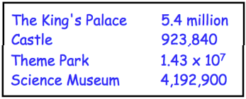


Example 13 - I do…
Example 14 – We do…
Example 15 – You do…
Steps | Write the following in ascending order: | Write the following in ascending order: | Write the following in ascending order:
1) Look for the smallest power of 10. This number will come first. 2) Repeat this step. If two powers of 10 are the same, look for the smallest ‘a’.
4 x 10³
6 x 10³
5 x 10⁴
8.3 x 10²
8.3 x 10²
8.4 x 10²
3.5 x 10⁷
3.6 x 10⁷
2.8 x 10⁸
Independent Practice
10. Write each of the following in ascending order:
5 x 10³ , 6 x 10⁴, 7 x 10⁴
7.8 x 10⁶ , 9.2 x 10⁶, 1.3 x 10⁷
2.4 x 10⁵ , 2.5 x 10⁵, 2.3 x 10⁶
1.2 x 10 , 1.3 x 10, 1.1 x 10²
8.8 x 10⁸ , 8.7 x 10⁹, 8.6 x 10¹⁰
3.589 x 10³ , 3.76 x 10³, 3.872 x 10⁴
11. The number of visits to some tourist attractions is shown in the table below.
Write the number of visitors to the Theme Park as an ordinary number.
Write the number of visitors to the Castle in standard form.
Write the attractions in ascending order of the number of visitors.
Castle, Science Museum, The King’s Palace, Theme Park

Slide 7
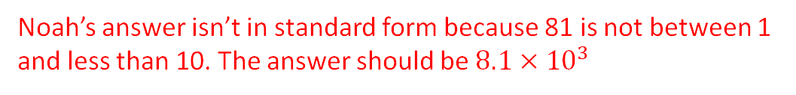
Re-writing numbers to be written in standard form
Example 16 - I do…
Example 17 – We do…
Example 18 – You do…
Steps | Write in standard form: | Write in standard form: | Write in standard form:
1) What does the ‘a’ value need to be? 2) How many more times do you need to multiply by 10 to keep it equal?
3.7 x 10⁵
4.2 x 10⁹
5.6 x 10⁷
Independent Practice
12. Write in standard form:
7.2 x 10⁴
8.4 x 10⁷
5 x 10⁴
2.1 x 10⁶
8 x 10⁶
4.6 x 10⁴
6 x 10⁶
7 x 10⁹
3 x 10¹⁷
2.933 x 10²⁴
Explain the mistake Noah has made and write the correct answer.
What was the original number Noah was trying to write?

Slide 8
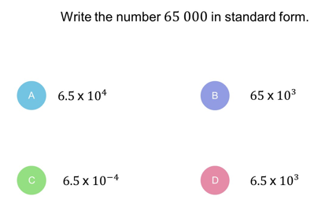
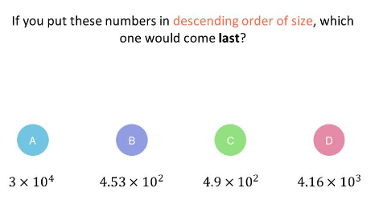
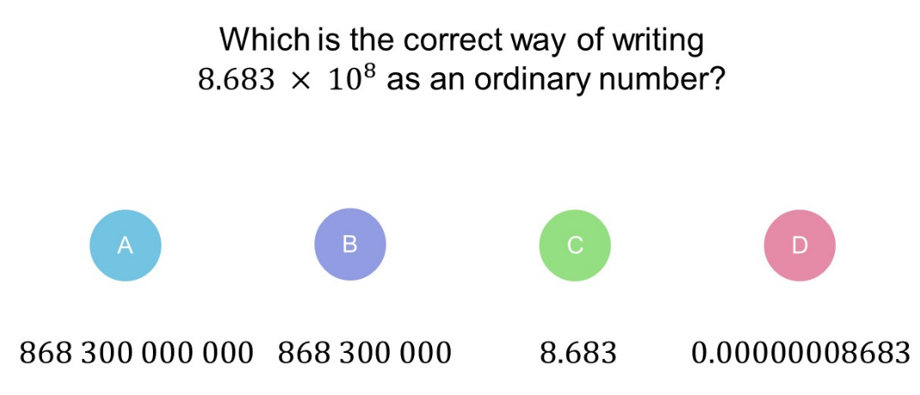
14. Re-write the following in standard form. As you work along each row, predict how it will differ from the previous question before you work out the answer.
Prediction/ Explanation
Answer | 5.6 x 10⁵ | 5.6 x 10⁶ | 5.6 x 10⁷
Prediction/ Explanation
Answer | 5.6 x 10⁸ | 5.6 x 10⁹ | 5.6 x 10¹⁰
Prediction/ Explanation
Answer | 3.2 x 10⁵ | 3.2 x 10⁴ | 3.2 x 10³
Skills Check

